Slide 1
FUDGEMART
Presented by:
Trisha Chakraborty

Slide 2
OUR CLIENT
FudgeFlix
FudgeMart
FudgeMart

Slide 3
BUSINESS PROCESSES
SALES REPORTING
CUSTOMER REVIEW
EMPLOYEE PAYROLL
DELIVERY EFFICIENCY

Slide 4
OUR BUSINESS PROCESSES
Customer Review: Analyzing the customer behavior under different product departments, based on the review rating for product and titles. This helps us to understand how the departments cater differently to different sections of people.
Delivery Efficiency: Determining the shipments which have a lot of difference between the requested and shipped date, based on their zip codes. This will help us understand the areas where the delivery process needs to be improved.

Slide 5
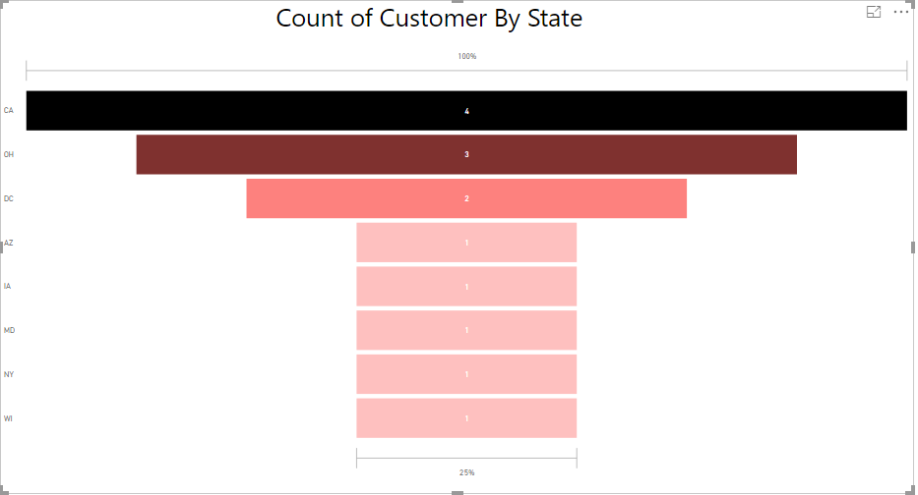
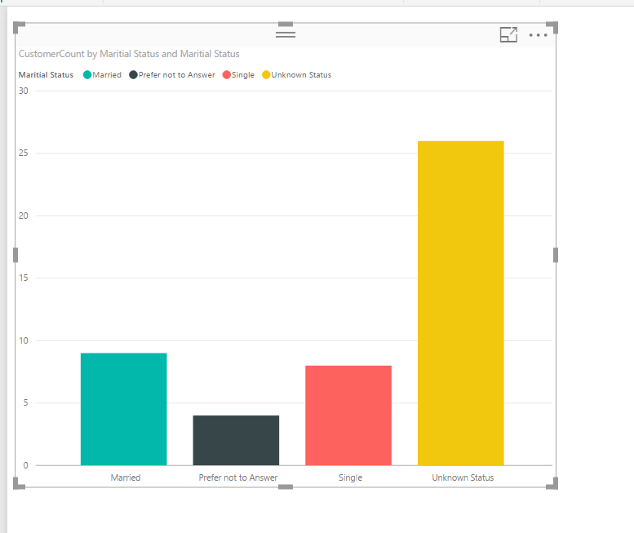
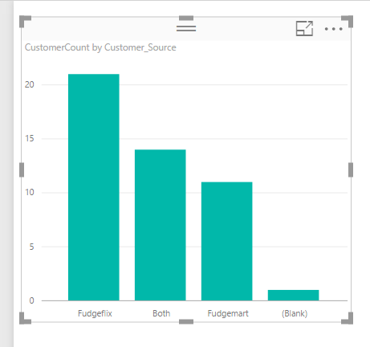
KNOWING OUR CUSTOMERS

Slide 6
DELIVERY EFFICIENCY

Slide 7
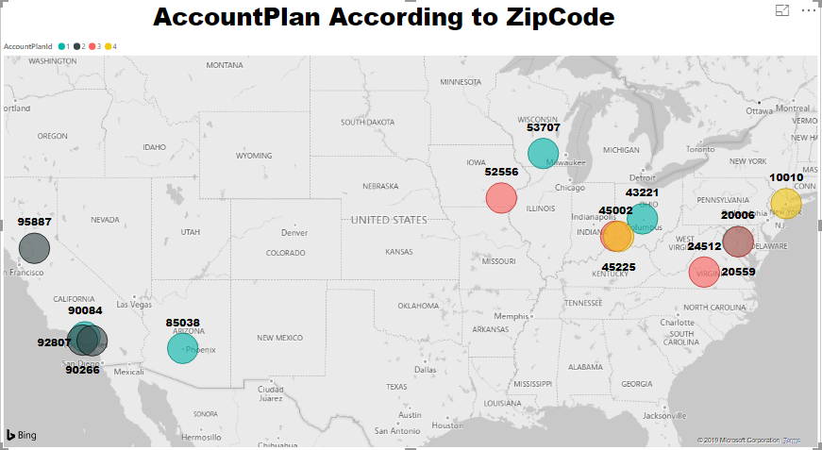
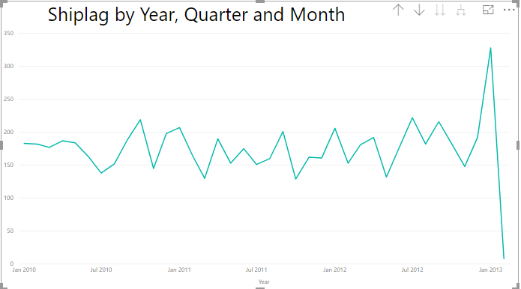

Slide 8
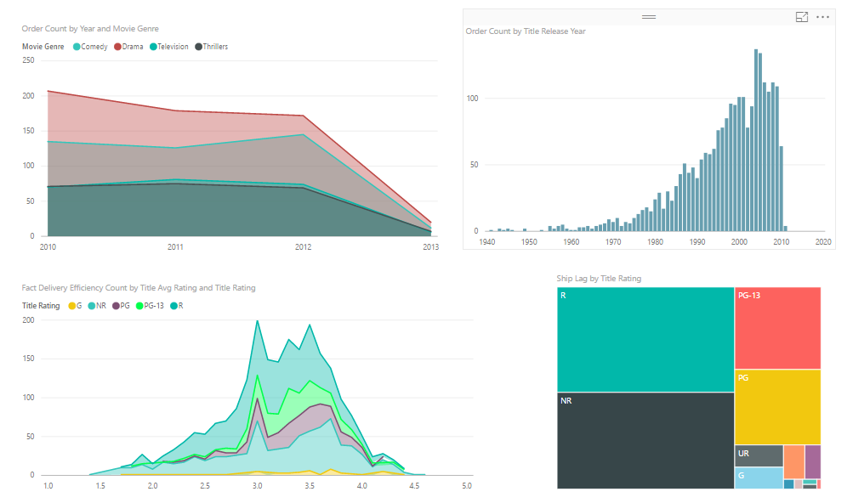
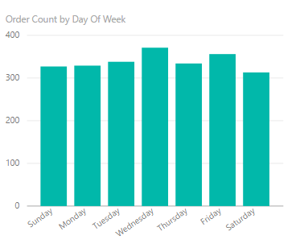
DELIVERY EFFICIENCY
Movies under the Drama genre have been ordered the most over the years, followed by Comedy, Television and Thrillers
Ship Lag for Drama has been highest over the years, so we need to understand if this is influenced by Order count, or another external factor
Order count has reduced drastically since 2011, due to other stiff competitors
We also see that the highest orders are received on Wednesdays, and are ordered comparatively lesser on weekends
Order count of television series is comparatively lesser than movies, hence they need to look at ways to improve television series

Slide 9
CUSTOMER REVIEW

Slide 10
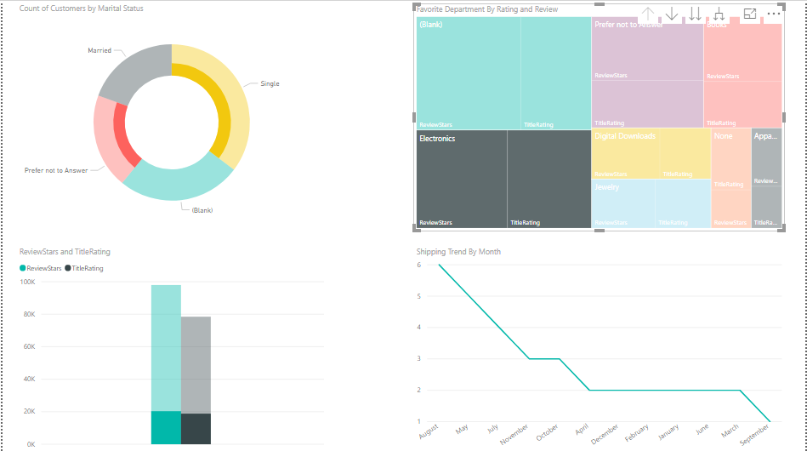

Slide 11
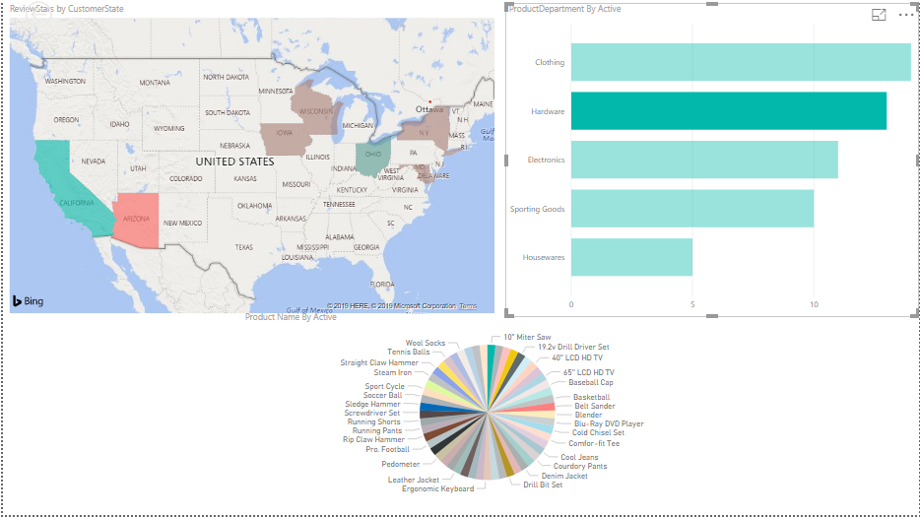

Slide 12
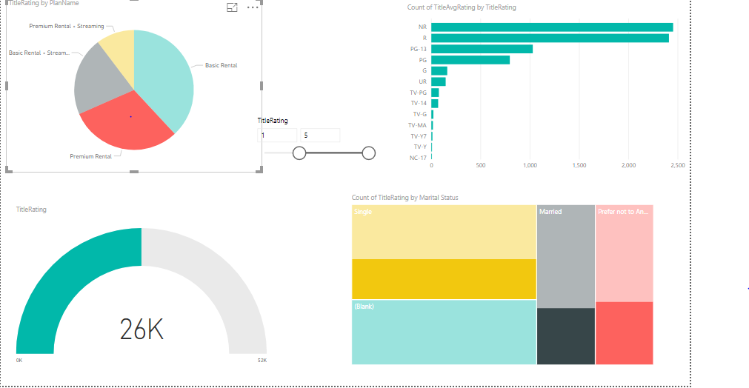

Slide 13
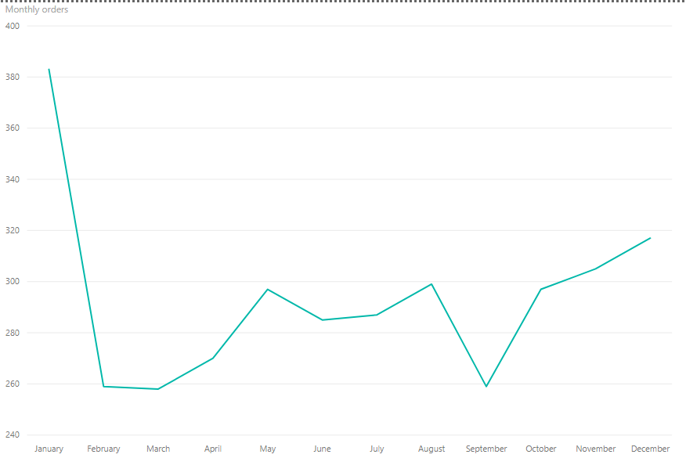
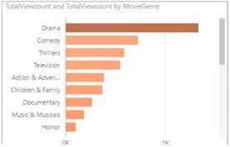
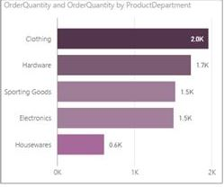
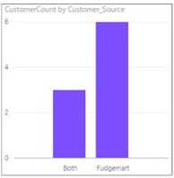

Slide 14
Customer Review
The favorite department of customers is Electronics followed by Books, Digital Downloads and Apparels
Electronics are majorly purchased by Single Customers
Apparels are majorly purchased by Married Customers
Highest Shipping Done was in the month of August
Title Rating: NR has the highest Average Rating
Basic Rental plan is the most purchased plan according to the marital status and average title rating
The favorite department of customers is Electronics followed by Books, Digital Downloads and Apparels
Drama is the highest trending title

Slide 15
THANK YOU

